Slide 1
AgroTrack
PIP2001 Capstone Project
Review-3
Batch Number: CIT-G33
Roll Number | Student Name
20211CIT0110 | S P BRAHMA CHAITANYA
20211CIT0156 | BHUVANESHWAR Y
20211CIT0147 | SHREYANKA B L
20211CIT0069 | DHANUSH M
Under the Supervision of,
Dr. Nihar Ranjan Nayak
Associate Professor
School of Computer Science and Engineering
Presidency University
Name of the Program: Capstone Project-PIP2001
Name of the HoD: Dr. Anandaraj S P
Name of the Program Project Coordinator: Dr. Sharmasth Vali Y
Name of the School Project Coordinators: Dr. Sampath A K / Dr. Abdul Khadar A / Mr. Md Ziaur Rahman

Slide 2
Introduction
Agriculture remains the backbone of many economies worldwide, but traditional farming methods face challenges due to climate variability, soil degradation, pest infestations, and inefficient use of resources.
How can farmers gain access to all farming cycle elements through a single platform that integrates retailing, leasing, and access to mandi prices, providing seamless transactions and agri-credit options.

Slide 3
Literature Review
This section highlights ten relevant research papers from IEEE on the intersection of agriculture and technology, focusing on smart farming, IoT solutions, and machine learning.
1. IoT-Based Smart Agriculture: An Overview
Advantages: Real-time monitoring, predictive analytics, and better crop management. Limitations: Requires high infrastructure investment, limited access in rural areas.
2. Application of Machine Learning in Crop Yield Prediction
Advantages: Early prediction allows for better planning and resource allocation. Limitations: Requires high-quality datasets and computing power.

Slide 4
Literature Review
3. Blockchain-Based Traceability Systems for Agriculture Supply Chains
Advantages: Improves trust and transparency among stakeholders. Limitations: Requires digital literacy and complex infrastructure.
4. Weather Prediction Models for Agriculture Applications
Advantages: Helps in planning sowing and harvesting periods. Limitations: Weather models are prone to inaccuracies.
5. Big Data Analytics in Agriculture: Case Studies and Applications
Advantages: Insights from big data can boost farm efficiency. Limitations: Challenges in managing large datasets.

Slide 5
Objectives
1. Information Accessibility
Provide farmers with real-time access to market prices, expert farming advice, and crop recommendations based on weather and soil conditions.
AgroTrack aims to address the knowledge gap that many farmers face by delivering critical information directly to their mobile devices. This includes up-to-date market prices, tailored farming advice, and scientifically backed crop recommendations that consider local weather and soil conditions. By making data and expert insights readily available, AgroTrack empowers farmers to make informed decisions that enhance crop health, productivity, and profitability.

Slide 6
Objectives
2. Financial Empowerment
Enable secure financial transactions and provide access to credit facilities tailored for farming needs.
Recognizing the financial challenges faced by smallholder farmers, AgroTrack incorporates financial tools that simplify access to credit and payment options. Through partnerships with financial institutions, the platform allows farmers to secure microloans and make seamless transactions for purchasing inputs like seeds, fertilizers, and equipment. This financial integration supports sustainable agricultural investment, helping farmers grow their operations and improve yields with essential resources.

Slide 7
Objectives
3. Market Integration & Evaluation
Connect farmers to a network of local and international markets and conduct field trials to assess and refine the platform’s effectiveness.
AgroTrack opens up direct market access by connecting farmers to potential buyers locally and internationally, reducing reliance on intermediaries and maximizing profit potential. This feature enables farmers to explore demand trends and align their crops with market needs. To ensure the platform’s usability and impact, AgroTrack will undergo real-world field trials in agricultural environments, gathering feedback from users and refining features to better meet farmers' needs. These trials are essential for validating AgroTrack's effectiveness in empowering farmers and fostering agricultural growth.

Slide 8
Algorithm
STORAGE FOR USER DATA
Firebase Firestore: Utilizes Firestore as a NoSQL database for real-time data storage and synchronization.
Data Structure: User information is stored in collections and documents, allowing for easy retrieval and updates.
SORTING DATA
OrderBy Queries: Implements sorting capabilities using the orderBy method to retrieve user data based on specific fields (e.g., name, date).
Efficiency: Sorting is performed server-side, optimizing data retrieval and minimizing network load.

Slide 9
Algorithm
FINDING DATA
Where Queries: Uses the where method to filter user data based on specific criteria (e.g., email, status).
Targeted Retrieval: Allows efficient searches for specific records without fetching unnecessary data.
TRANSFERRING DATA TO USERS
Real-Time Listeners: Sets up listeners with Firestore's snapshots() method to automatically update the UI when data changes.
User Experience: Provides instant feedback to users about changes in their data without needing manual refreshes.

Slide 10
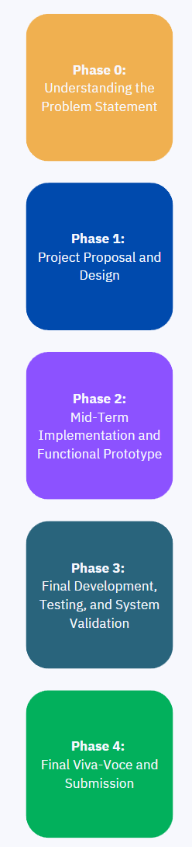
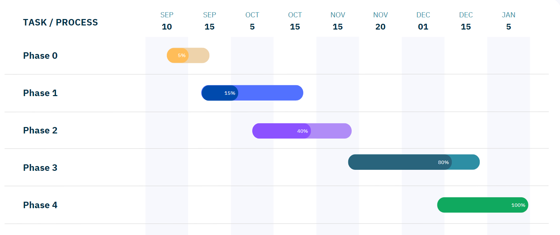
Project Timeline (Gantt Chart)

Slide 11
Expected Outcome
Farmers will have a streamlined platform for accessing farming cycle resources.
Enhanced decision-making for farmers, leading to increased productivity.
Real-time market data integration and crop recommendations.
Secure access to Agri-credit and financial services.

Slide 12
Conclusion
AgroTrack aims to revolutionize how farmers interact with the agricultural ecosystem, offering an all-in-one solution for their farming needs.
By leveraging IoT, secure transactions, and expert advice, AgroTrack will contribute to the adoption of modern farming practices and improved economic conditions for farmers.

Slide 13
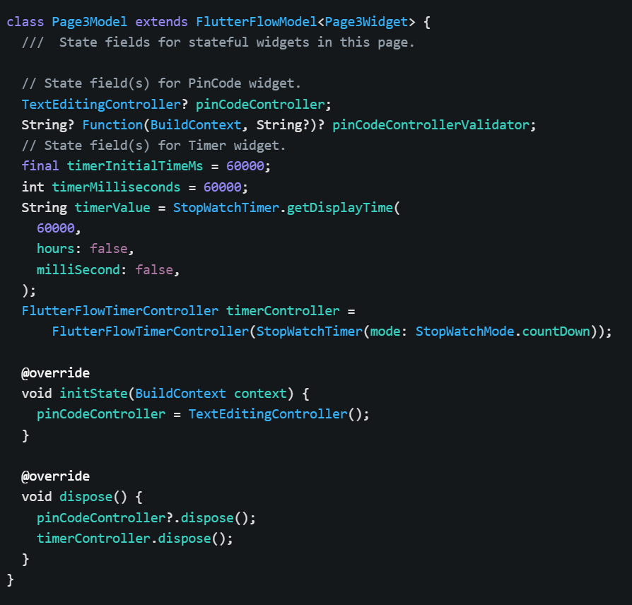
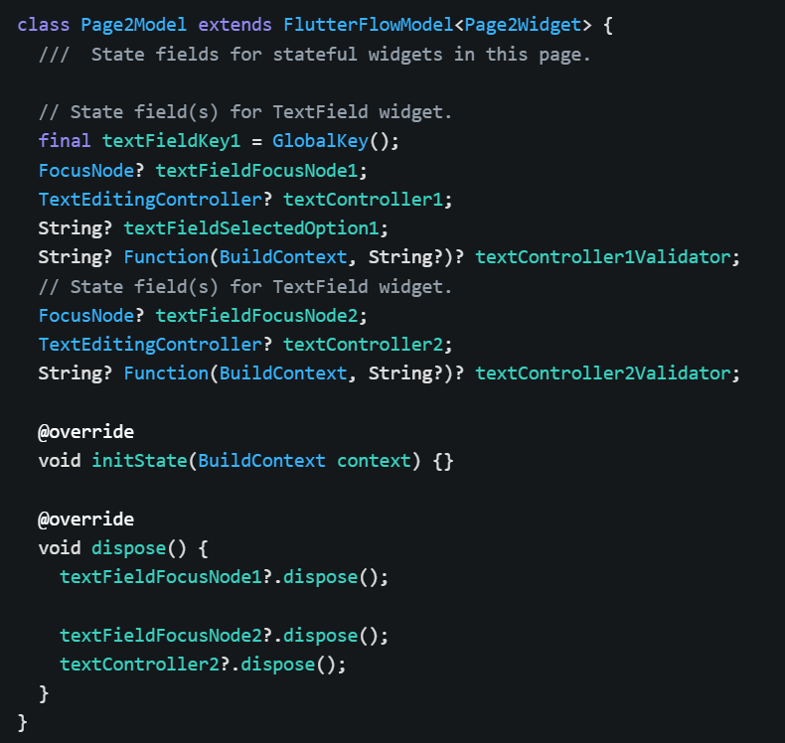
Source Code

Slide 14
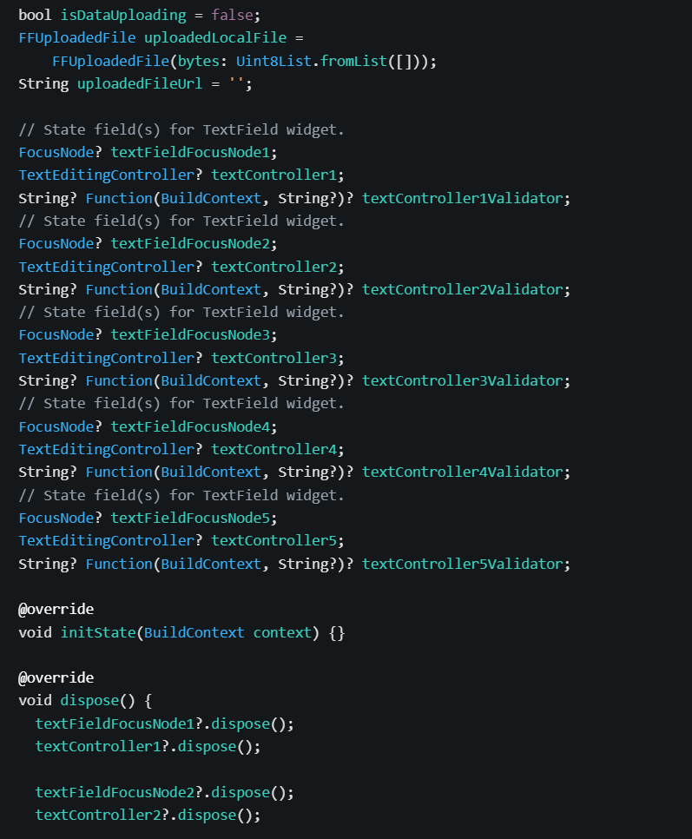
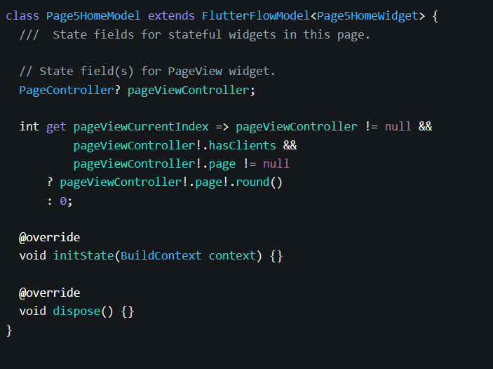
Source Code

Slide 15
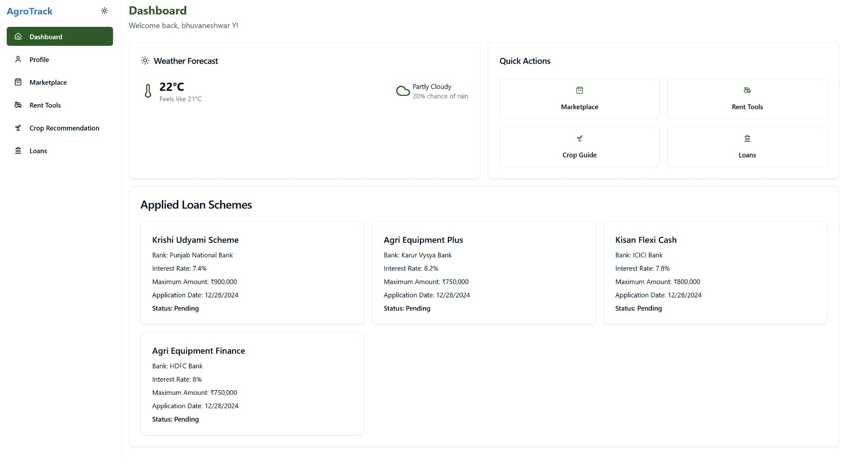
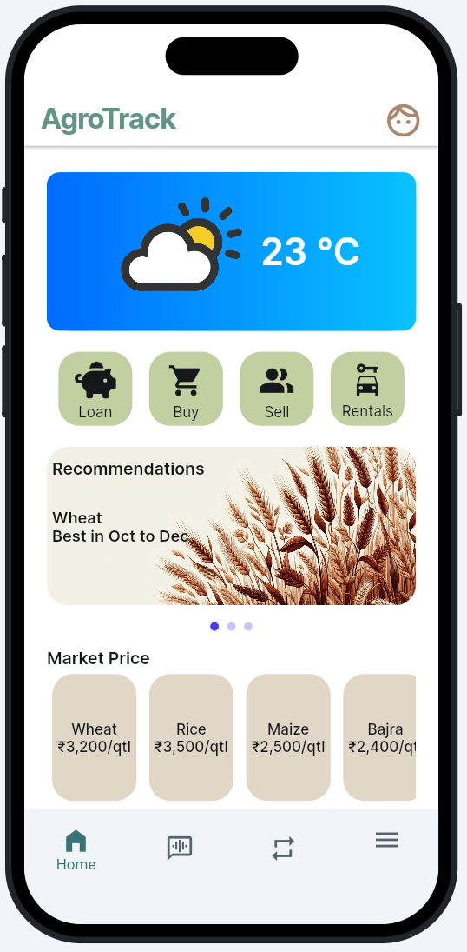
Results
Fig 1: AgroTrack Home (WEBPAGE AND MOBILE APPLICATION)

Slide 16
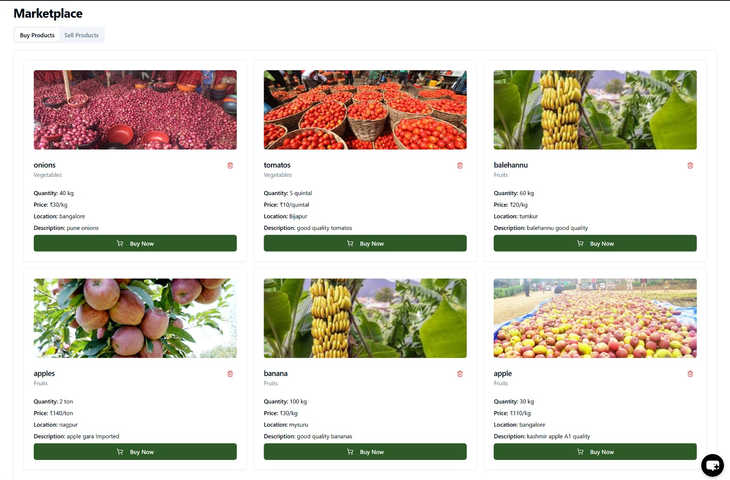
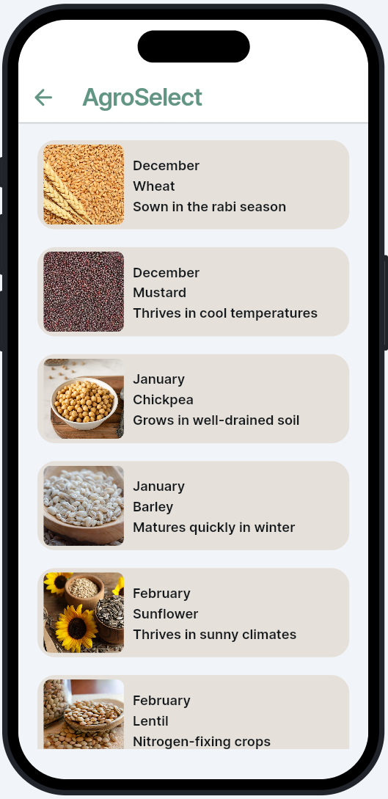
Results
Fig 2: Crop Recommendation Page (WEBPAGE AND MOBILE APPLICATION)

Slide 17
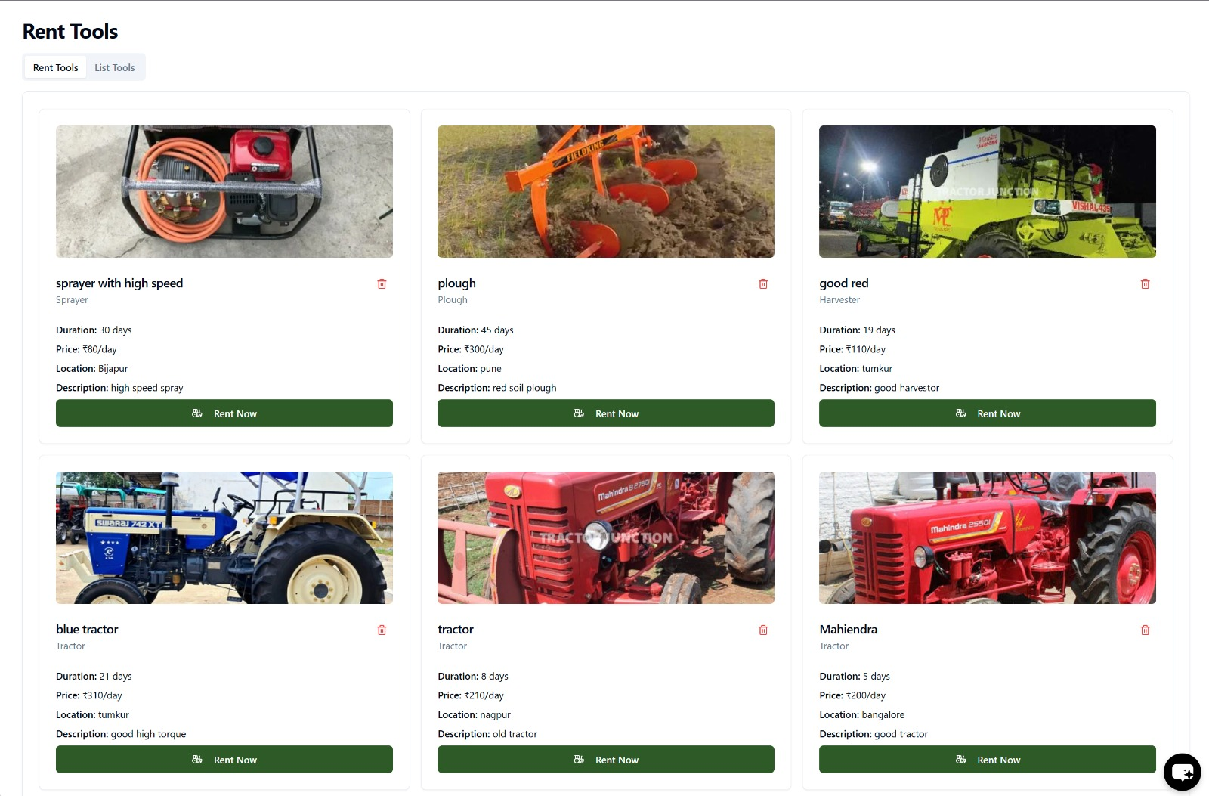
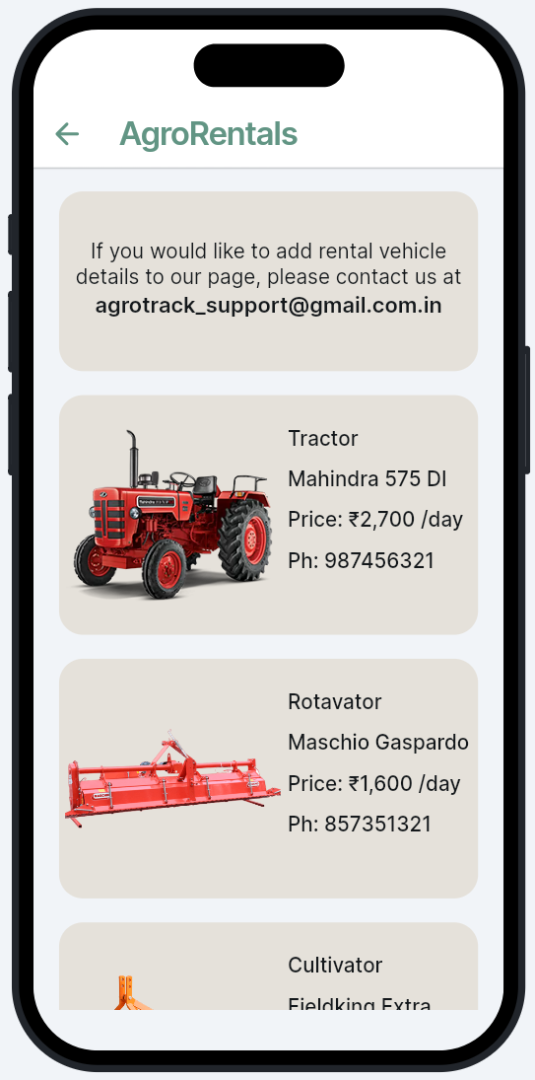
Results
Fig 3: Rentals Page (WEBPAGE AND MOBILE APPLICATION)

Slide 18
References (IEEE Paper)
Magno, L. P., & Moraes, M. L. (2020). Internet-of-Things (IoT)-based smart agriculture: Toward making the fields talk. IEEE Access. Summary: This paper explores IoT applications in agriculture, enhancing decision-making via real-time data from sensors, aligning with your app’s weather data and crop recommendations.
Silva, J. L., & De Souza, M. C. (2019). A farmer’s mobile market: Agricultural e-commerce. IEEE Transactions on E-Commerce. Summary: This paper focuses on e-commerce solutions for agricultural products, aligning with your app’s market connection features for farmers globally.
Sharma, A. N., & Verma, K. (2021). Smart agricultural data management system. IEEE Systems Journal. Summary: This paper discusses data management systems for agriculture, similar to your app's market listings, crop prices, and vendor details.
Patel, P. S., & Jain, R. K. (2018). Mobile applications for farmer market and crop forecasting. IEEE Mobile Computing. Summary: This paper covers mobile apps for connecting farmers to markets and crop forecasting, aligning with your app’s functionalities for market and crop sale.
Singh, D. A., & Kumar, A. (2022). Machine learning and data analytics in precision agriculture. IEEE Transactions on AI. Summary: This paper focuses on the use of machine learning for crop yield predictions, relevant to your app’s feature for technology-enhanced farming practices.

Slide 19


